Slide 1

DEPARTMENT OF COMPUTER SCIENCE AND ENGINEERING
Project name : Public Transport Optimization
Team name : Proj_224782_Team_4
Team members : ASHWINI E(113321104006)
BENSIHA A(113321104008)
DEYAA ASMI M(113321104013)
DHANALAKSHMI S(113321104014)

Slide 2
Project Definition:
The Public Transport Optimization project aims to enhance the efficiency , accessibility , and sustainability of public transportation systems within a designated urban area.
This project meets the evolving needs of the community while reducing traffic congestion and environmental impact.

Slide 3
Objectives:
Data Collection and Analysis
Route Optimization
Demand-Responsive Services
Sustainability and Electrification
Accessibility and Inclusivity
User Experience Enhancement
Public Engagement
Performance Metrics and Monitoring
Cost-Benefit Analysis

Slide 4
IoT Sensor Design:
Choose appropriate sensors.
Select communication protocols.
Install sensors on vehicles, infrastructure, and key locations.
Use edge devices for data preprocessing.
Implement encryption and authentication to protect sensor data.
Optimize power sources and consumption.
Set up cloud platforms.
Develop real-time analytics for insights and alerts.
Create user-friendly dashboards for monitoring.
Design for easy addition of new sensors and scalability.
Implement remote diagnostics for maintenance.
Ensure compliance with local regulations and privacy laws.

Slide 5
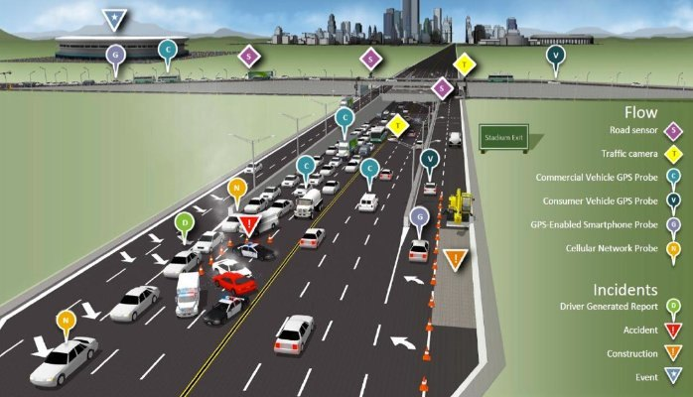
IoT Sensor Design:

Slide 6
Real-Time Transit Information Platform:
Gather real-time data from various sources. Create user-friendly apps and dashboards.
Ensure timely data updates for passengers and operators.
Implement algorithms to adjust routes and schedules based on real-time data.
Design for passengers with disabilities. Include info on different transportation modes and services.
Enable electronic ticketing and payments.
Protect passenger data and comply with privacy regulations.
Allow passengers to report issues and provide feedback.
Establish a support system for users and regular maintenance.
Encourage third-party developers to create transit-related apps.
Design for future growth and expansion.
Provide tools for performance monitoring and analysis.

Slide 7
Integration Approach:
Centralize data in a unified platform or database for easy access and analysis.
Develop APIs for seamless integration with third-party systems and apps.
Implement real-time data processing to enable instant updates and insights.
Integrate machine learning algorithms for predictive analysis and route optimization.
Create intuitive user interfaces for passengers, operators, and administrators.
Include data on various transportation modes to offer comprehensive transit options.

Slide 8
Integration Approach:
Integrate electronic ticketing and payment solutions for convenience.
Ensure data security and compliance with privacy regulations.
Design the system to scale with growing data and user needs.
Establish mechanisms for user feedback to continually improve service.
Implement analytics tools for monitoring and reporting on system performance.

Slide 9
THANK YOU

